Slide 1



VIDYAPEETH
BATCH CODE: 51-AJ221MA 2025
SUBJECT NAME: Physics
CHAPTER NAME:
Motion in Straight Line
Lecture No.
01
By – Amarjeet Sir

Slide 2

Today's Goal
Today's Goal
Subtopic
..
Introduction
Subtopic
..
Position vector, displacement and distance
Subtopic
..
Average Velocity, average speed & Average Acceleration

Slide 3
Topic: Quick Last Lecture Revision - 01
Today's Goal
CONTENT

Slide 4
INTRODUCTION
Today's Goal

Slide 5
POSITION AND FRAME OF REFERENCE
Today's Goal

Slide 6
DISTANCE OR PATH LENGTH
Today's Goal

Slide 7
DISPLACEMENT
Today's Goal
Distance ≥ |Displacement|

Slide 8
Topic: Question
#Q. A particle moves in a circle of radius R. In half the period of revolution its displacement is _____ and distance covered is _______.

Slide 9
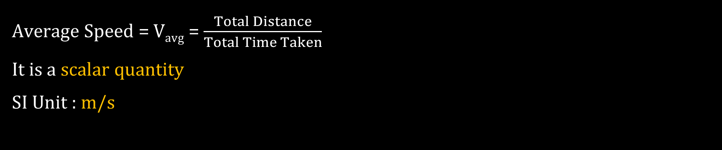
AVERAGE SPEED
Average Speed = $Vavg$ = $\frac{Total Distance}{Total Time Taken}$
It is a scalar quantity
SI Unit : m/s

Slide 10
Topic: Question
#Q. A car travels from town A to town B at a speed 40Km/hr and returns to town A at 80 Km/hr. Find the average speed.

Slide 11

AVERAGE VELOCITY
Average velocity = $\frac{\text{Total} \text{displacement}}{\text{Total} \text{time} \text{taken}}$
Or
${\vec{V}}_{avg}=\frac{{\vec{r}}_{2} − {\vec{r}}_{1}}{Δt}=\frac{Δ\vec{r}}{Δt}$

Slide 12
Topic: Question
#Q. A particle that covers half the distance with V₁ speed and other half with V₂ speed. Find average speed.

Slide 13
Topic: Question
#Q. A particle that travels half the time with V₁ speed and other half with V₂ speed.

Slide 14
Topic: Question
#Q. A man travelled half of the distance with a velocity v₀. The remaining part of the distance was covered with velocity v₁ for half of the time and with velocity v₂ for the other half of the time. Find the average speed of the man over the whole time of motion.
[I E IRODOV]

Slide 15
Topic: Question
#Q. A car runs at a constant speed on a circular track of radius 100 𝒎, taking 62.8 seconds for every circular lap. The average velocity and average speed for each circular lap respectively is :
A.
0, 0
0, 10 m/s
10 m/s, 10 m/s
10 m/s, 0
B.
C.
D.

Slide 16

AVERAGE ACCELERATION
Average acceleration of a particle is defined as:
$\vec{a}avg=\frac{\vec{V}2 − \vec{V}1}{Δt}$ = $\frac{Δ\vec{V}}{Δt}$

Slide 17

Topic: Question
#Q. A particle is moving with a velocity of 10 𝒎/𝒔 towards east. After 10𝒔 its velocity changes to 10 𝒎/𝒔 towards north. Its average acceleration is:
A.
Zero
$\sqrt{2}$ $m/s$² towards $N$-$W$
$\frac{1}{\sqrt{2}}$ $m/s$² towards $N$-$E$
$\frac{1}{\sqrt{2}}$ $m/s$² towards $N$-$W$
B.
C.
D.

Slide 18

INSTANTANEOUS VELOCITY
$\vec{V}=\frac{d\vec{r}}{dt}$
Direction of instantaneous velocity is taken along the tangent of the path.
Slope of displacement-time graph for one dimensional motion gives velocity.

Slide 19

INSTANTANEOUS SPEED
MAGNITUDE OF VELOCITY IS SPEED.
$\left|\vec{V}\right|=\left|\frac{d\vec{r}}{dt}\right|$
Magnitude of Slope of displacement-time graph for one dimensional motion gives speed.

Slide 20

INSTANTANEOUS ACCELERATION
Acceleration is rate of change of velocity of an object.
for one dimensional motion,
$a\left(t\right)=\frac{dv}{dt}=slope of v−t graph$

Slide 21

Topic: Question
[H C V ]
#Q. Pick the correct statements:
A.
Average speed of a particle in a given time is never less than the magnitude of the average velocity.
It is possible to have a situation in which $\left|\frac{d\vec{v}}{dt}\right|≠0$ but $\frac{d}{dt}|\vec{v}|=0$
The average velocity of a particle is zero in a time interval. It is possible that the instantaneous velocity is never zero in the interval.
The average velocity of a particle moving on a straight line is zero in a time interval. It is possible that the instantaneous velocity is never zero in the interval. (Infinite accelerations are not allowed.)
B.
C.
D.

Slide 22
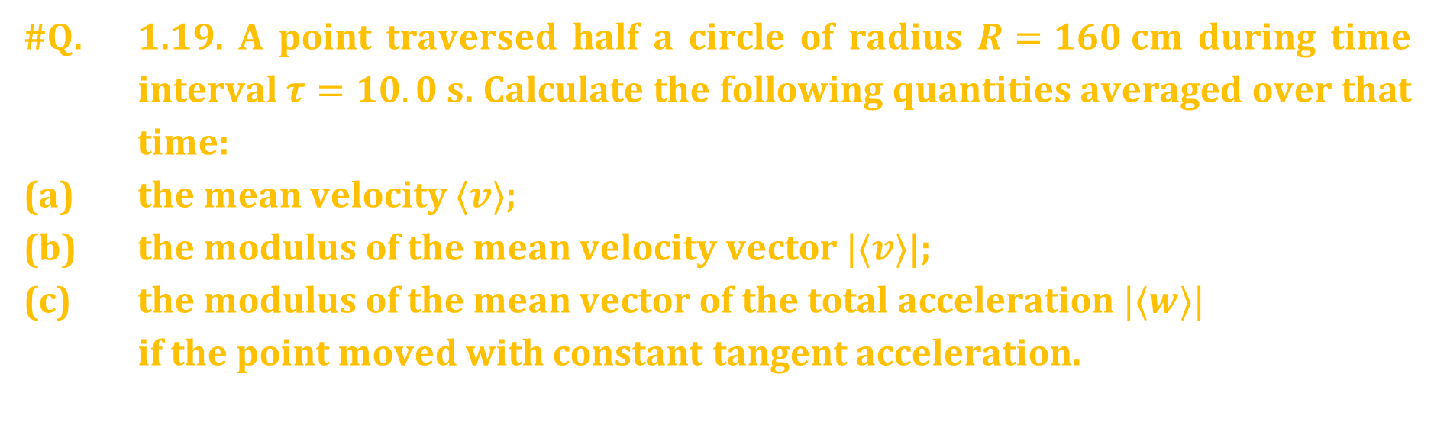
Topic: Question
#Q. 1.19. A point traversed half a circle of radius $R=160 cm$ during time interval $τ=10.0 s$. Calculate the following quantities averaged over that time:
(a) the mean velocity $⟨v⟩$;
(b) the modulus of the mean velocity vector $|⟨v⟩|$;
(c) the modulus of the mean vector of the total acceleration $|⟨w⟩|$
if the point moved with constant tangent acceleration.
[I E IRODOV]

Slide 23
Topic: Question
[H C V ]
#Q. The velocity of a particle is zero at t = 0.
A.
The acceleration at t = 0 must be zero.
The acceleration at t = 0 may be zero.
If the acceleration is zero from t = 0 to t = 10 s, the speed is also zero in this interval.
If the speed is zero from t = 0 to t = 10 s the acceleration is also zero in this interval.
B.
C.
D.

Slide 24

Topic: Question
#Q. An object is moving along the x axis with position as a function of time given by x = x(t). Point O is at x = 0. The object is definitely moving toward O when
$\frac{dx}{dt}$ < 0
$\frac{dx}{dt}$ >0
$\frac{d\left(x2\right)}{dt}$ < 0
$\frac{d\left(x2 \right)}{dt}$ > 0
A.
B.
C.
D.

Slide 25

Topic: Question
#Q. A particle starts moving rectilinearly at time t = 0 such that its velocity ‘v’ changes with time ‘t’ according to the equation v = t² – t where t is in seconds and v is in m/s. The time interval for which the particle retards is
A.
t < $\frac{1}{2}$
$\frac{1}{2}$ < t < 1
t > 1
t < $\frac{1}{2}$ and t > 1
B.
C.
D.

Slide 26
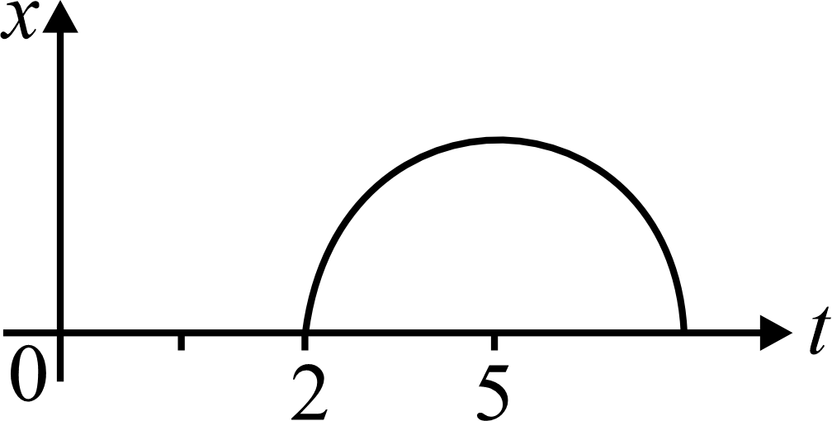
Topic: Question
#Q. Position-time graph is shown which is a semicircle from t = 2 to t = 8 sec. Find time t at which the instantaneous velocity, is equal to average velocity over first t seconds
A.
4.8 sec
3.2 sec
2.4 sec
5 sec
B.
C.
D.

Slide 27
Topic: Homework-1
Today's Goal
DPP
Module
- Exercise Name
Homework - 01
DPP NO | Question No
DPP -1 | 1,2,3,4
DPP -2 | 2,5,7,10
Module Page No | Question No
Page No- 21 | 1,2,3,4
Page No -22 | 7,9,15

Slide 28
Next Lecture's Goal
Today's Goal
Chap Name
..
1. Sub Top
..
2. Sub Top
..
3. Sub Top
..
4. Sub Top
..
5. Sub Top
..

Slide 29





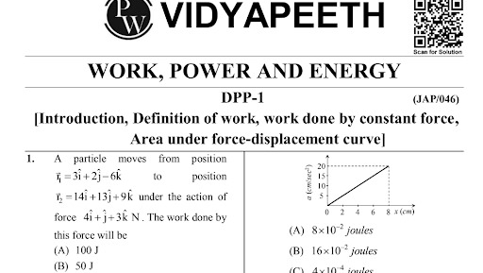

Rate your today’s class in the Batch
Solve the DPP and
check Solution
2026
Thank You!!!!
“SCAN” to join our
“TELEGRAM” channel
Check your performance through Student Dashboard

